Slide 1

Online Safety
How can I keep my children safe?
Welcome!
What risks are involved?
What technology are children using?

Slide 2

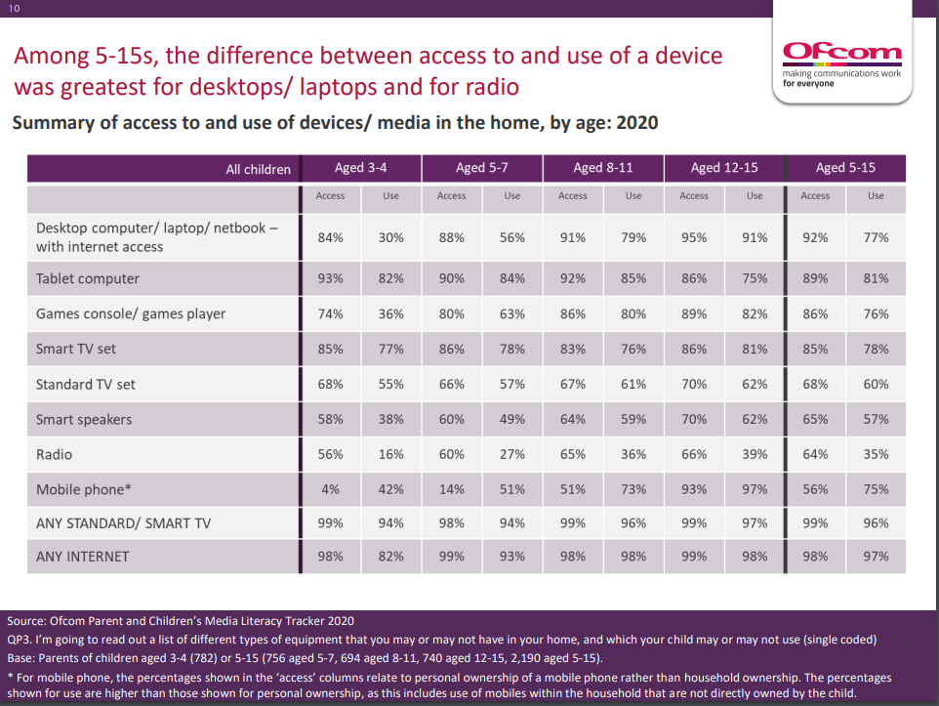

Q: What devices are your children using at home?

Slide 3
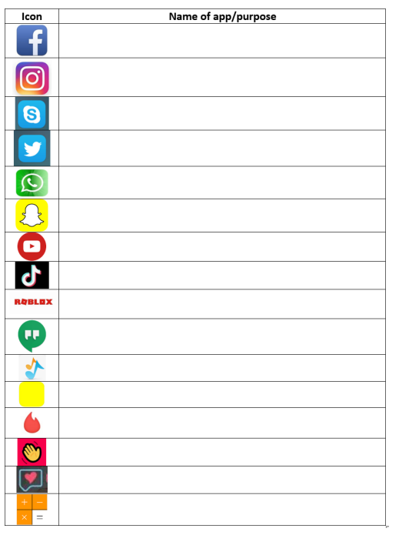
Q: How many of these apps do you know?

Slide 4
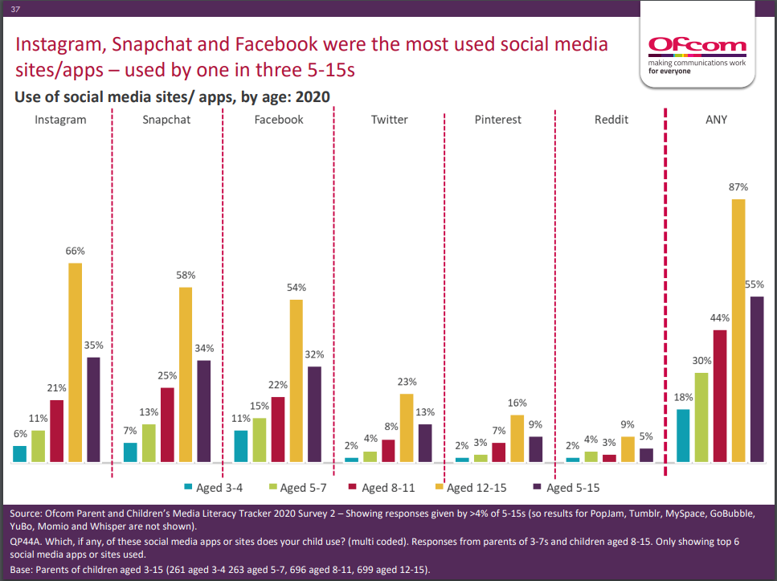
Q: What apps are your children using at home?

Slide 5
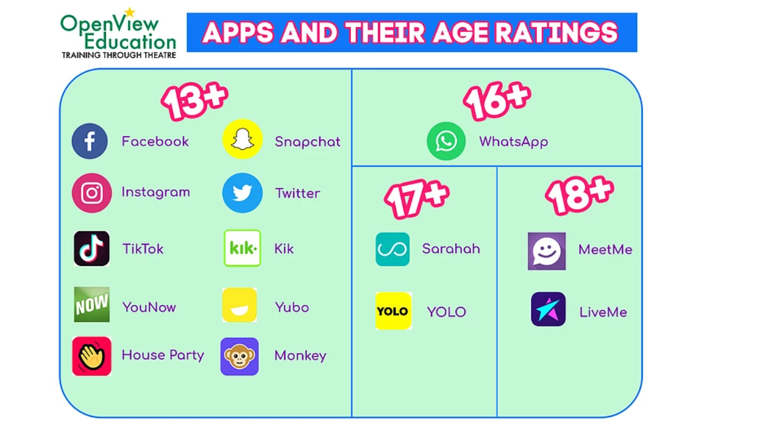
Which of these apps are your children using at home?
How do you manage the age restriction? Eg Whatsapp

Slide 6
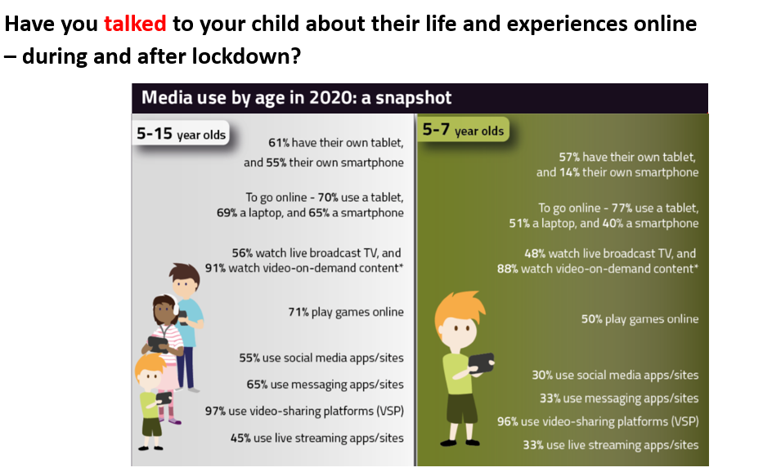

Slide 7
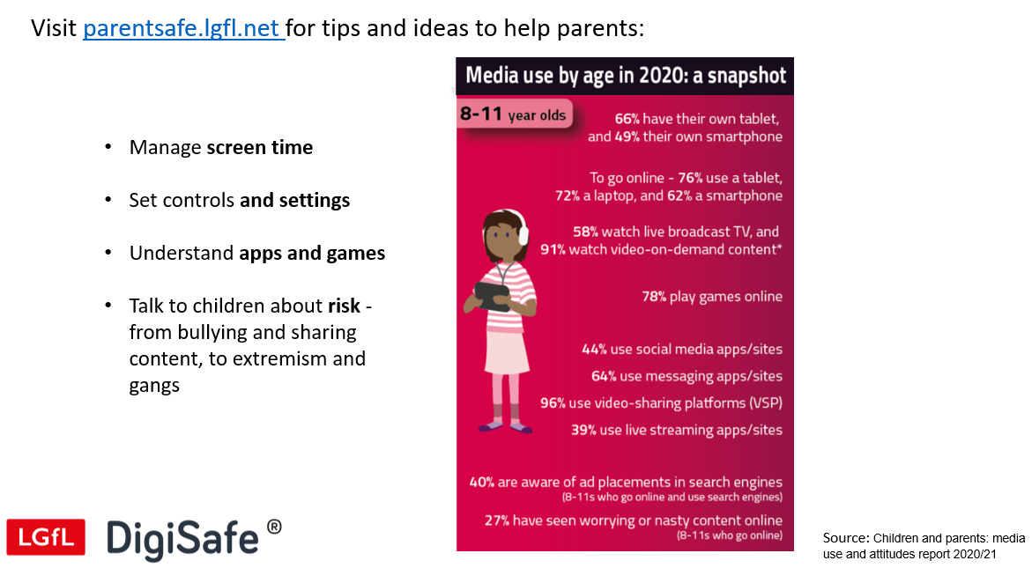

Slide 8
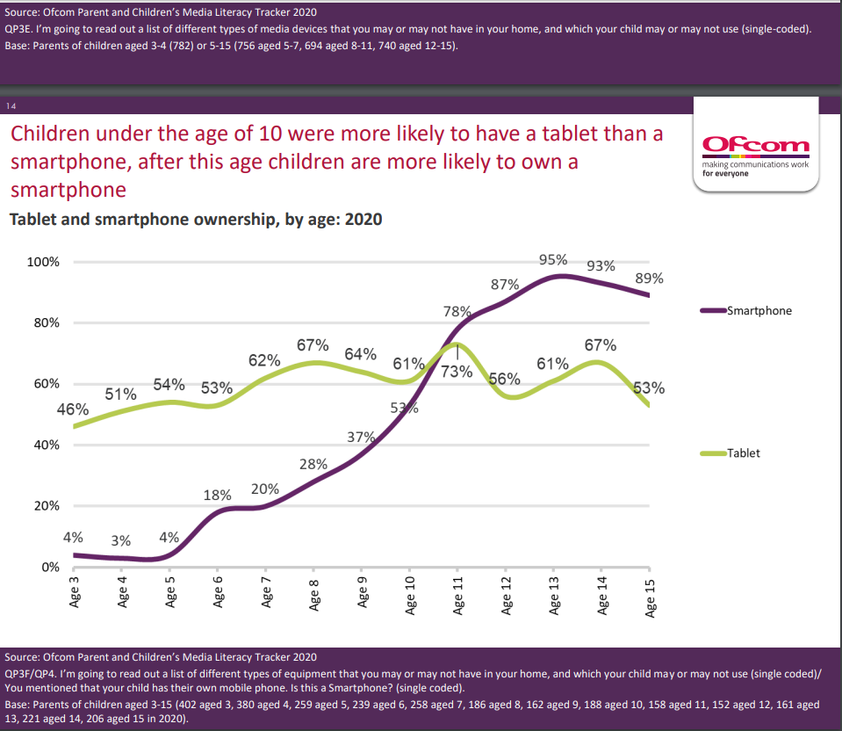

Slide 9




What games are your children playing online?
Look here for information about games, guides, ratings etc
What games are currently popular?

Slide 10
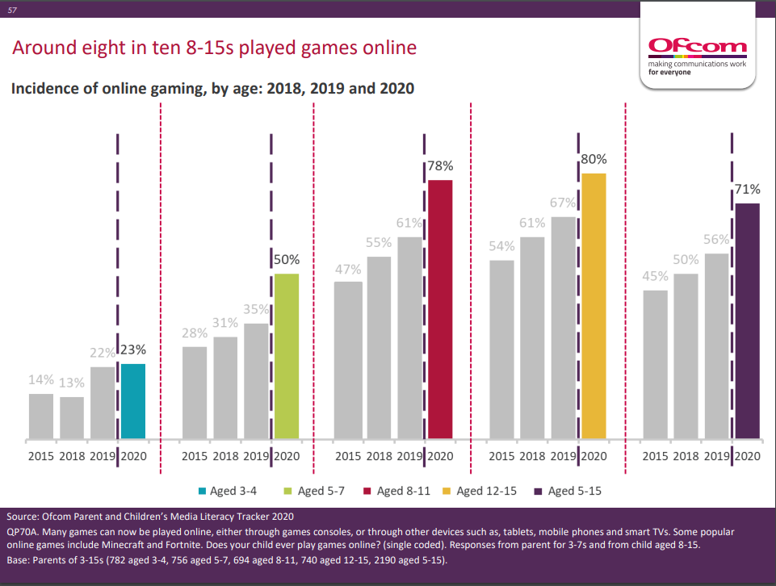

Slide 11
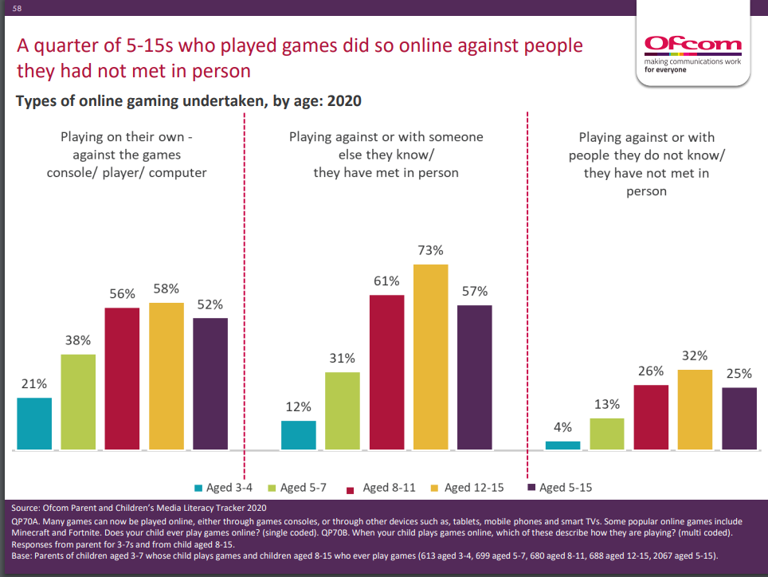

Slide 12

https://pegi.info/

Slide 13
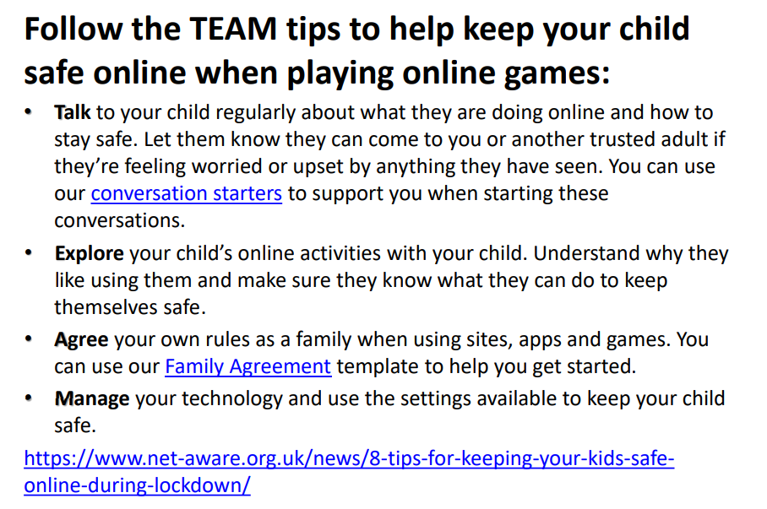
How can we keep our children safe online?

Slide 14
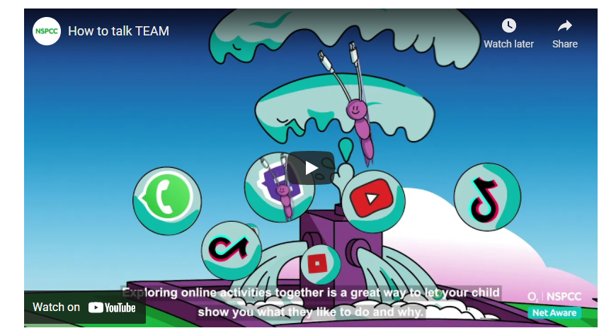
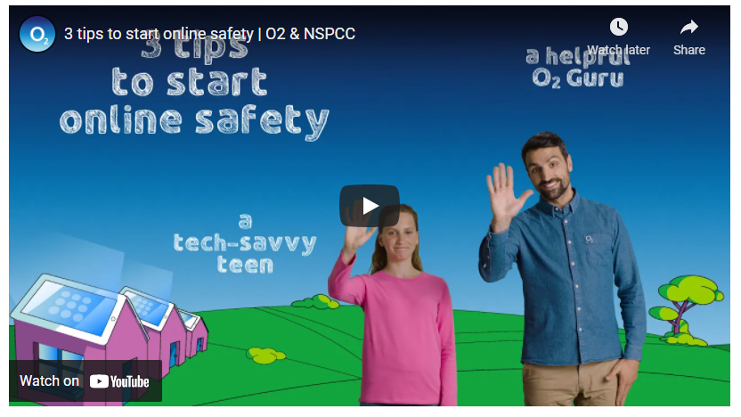
Talk to your child regularly about what they’re doing online and how to stay safe. Let them know they can come to you or another trusted adult if they’re feeling worried or upset by anything they have seen. You can use our conversation starters to support you when starting these conversations.
Videos are available in different languages
https://www.net-aware.org.uk/

Slide 15
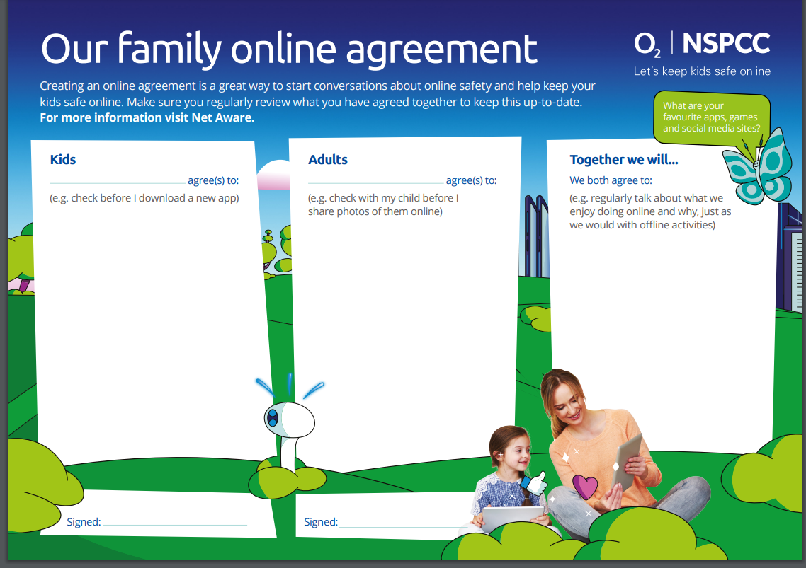

Slide 16
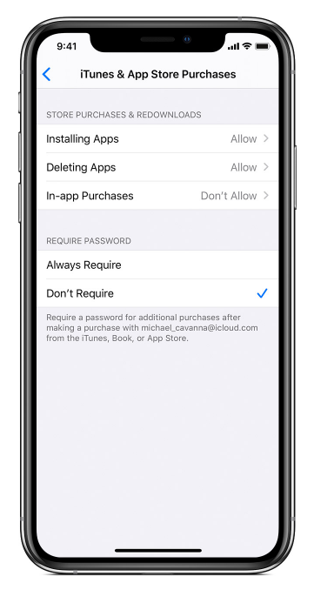
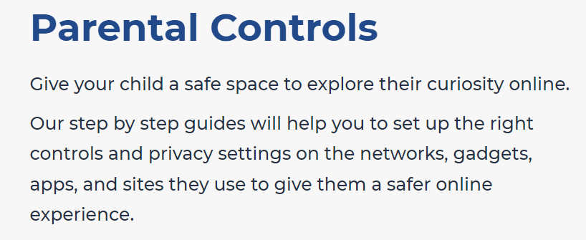



Parental Controls
Explore resources together
Manage your technology and use the settings available to keep your child safe. Use our reviews to explore parental controls and safety settings on your child's favourite app, site or game.
https://www.net-aware.org.uk/networks/

Slide 17
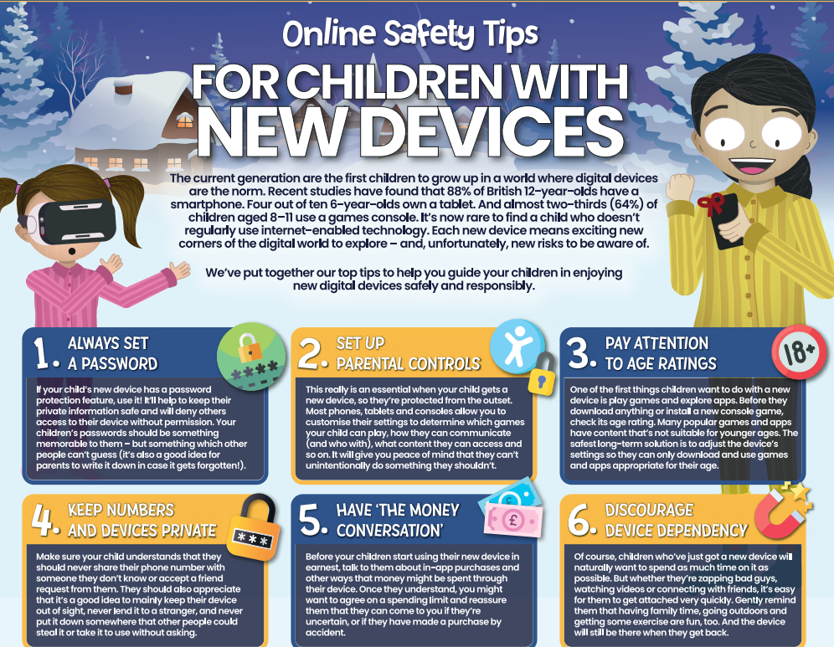

Slide 18
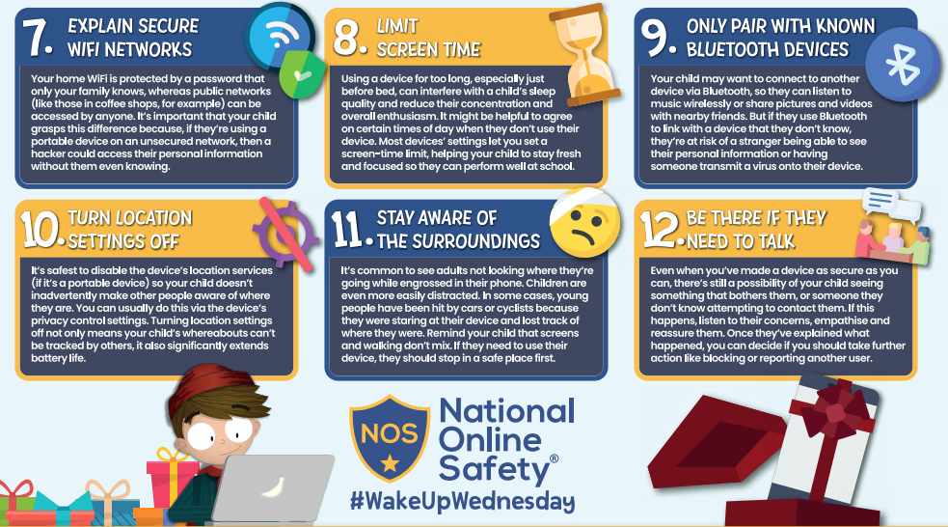

Slide 19

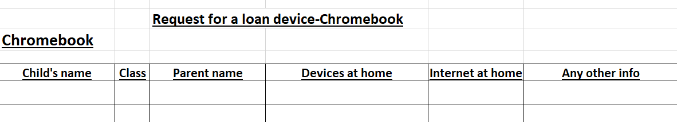
Loan devices and 4G routers
Please sign up if you feel your child would benefit from a loan device from school or contact the school office.

